Slide 1
National Institute of Electronics Ministry of Science & Technology-Islamabad
National Institute of Electronics
A presentation to Honorable Members of National Assembly Standing Committee on Science & Technology
By
Dr. Basharat Mahmood, Director General NIE
6th July, 2015

Slide 2
Sequence of Presentation
Introduction | Marketable Products
Mission Statement | Benefits
Main Functions | Business Plan
Key Expertise | Innovative Products
Research & Development Lab | PSDP Projects
Human Resource | Joint Projects with NESCOM
Budget Allocation | Problems & Issues
Recent Activities | Recommendation for Approval

Slide 3
Introduction
It is an autonomous R&D Organization under the administrative control of Ministry of Science & Technology.
Established through Presidential Ordinance No. lll of 1979.
Executive Committee (EC) of The Governing Body consists of Director General and Directors of Divisions (NIE). EC is responsible for day to day functioning of the Institute.
Formulation of Policies & Programs vests in Governing Body.
Composition of Governing Body:
Director General and Directors of Divisions (NIE).
Five members representing the Ministries and Organizations related to electronics (Ministry of Science & Technology, Finance, Planning Development & Reforms, Information Technology, Industries Production.
A member representing Universities nominated by HEC.

Slide 4
Mission Statement
Role is to become Center of Excellence in the field of Electronics in Pakistan at Regional and International level with the collaboration of academia, public / private, Industrial & strategic sectors, fulfilling their needs through Design Research & Development, Small Scale Production and Training.

Slide 5
Main Functions (Laid Down in Ordinance)
To carry out design and development work in vital areas of electronics.
To design & develop items of common utility for the various user organizations and production units and assist in augmenting the local content in production.
To develop know-how in advanced electronic techniques of value & exchange specialized know-how with other Research Centers.
To impart advanced training in electronics.
(cont…)

Slide 6
Main Functions (Laid down in Ordinance)
To develop expertise in digital electronic techniques to enable its applications to control systems, data processing and data transmission equipment of the future.
To establish close liaison with other organizations engaged in R&D, academic and production activities.
Small scale production of specialized components, ICs and electronic equipment.
To arrange seminars & conferences.

Slide 7
Key Expertise
NIE
Design Research & Dev.
Consultancy/
Services
Small Scale Production
Human Resource Dev.

Slide 8
Research & Development Labs (key research areas)
Power Electronics
Automation & Control Engg.
Communication Engineering
Integrated Circuits (IC) Design
Printed Circuit Boards (PCB)
Centre for S/W Dev.& training in Advance Database
SMT Pilot Production Line (Automatic)
NIE

Slide 9
Director General
Director Development
Director
Research
Chief Research Officers
Director Technical Services & Cord
Project Directors
Director
Finance
Principal Research Officers
Balancing Modernization & Rehabilitation (BMR)
Accounts
Coordination
Communication Lab
Power Electronic
Admin Section
Automation & Control Engineering
Personnel Section
Procurement Section
IC Design Center
Centre for Quality Testing & Certification
Store
Centre for Software Development
Library
PCB Design & Fabrication
Training Center
Workshop/Publications

Slide 10
Human Resource Details
 | Sanctioned | Filled-in | Vacant
Researcher/ Scientists/ Engineers | 71 | 24 | 47
Technicians/ Supporting staff | 63 | 35 | 28
Non- Technical | 89 | 62 | 27
Total: | 223 | 121 | 102
Recruitment process is in progress to fill the vacant posts.

Slide 11
Human Resource PSDP (BMR)
 | Filled-in
Researcher/ Scientists/ Engineers | 22
Software Engineer | 06
Technicians/ Supporting staff | 09
Non- Technical | 03
Total: | 40

Slide 12
Budget Allocation (Rs. in Million)
Development/PSDP Budget
Year | Allocation | Release
2011-12 | 125.00 | 97.80
2012-13 | 87.016 | 78.664
2013-14 | 156.050 | 156.050
2014-15 | 50.00 | 45.00
2015-16 | 59.00 | 00
Non-Development Budget
2011-12 | 94.196 | 94.196
2012-13 | 95.494 | 94.494
2013-14 | 95.441 | 95.441
2014-15 | 96.000 | 96.000
2015-16 | 112.00 | 00

Slide 13
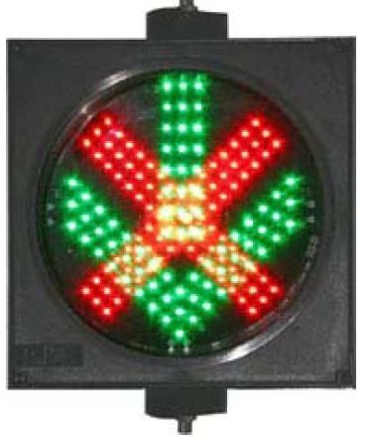
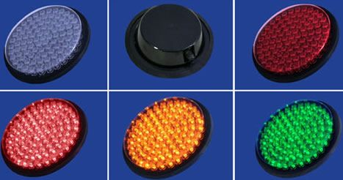
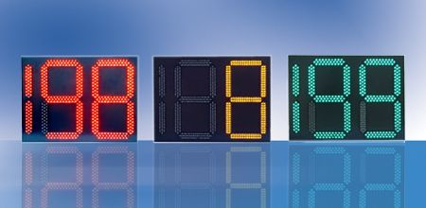
Power Electronics
LED Based Energy Efficient Lights
Solar Charge Controller
Energy Audit
Traffic Controller Light
Electronic Voting Machine (Prototype)
13

Slide 14
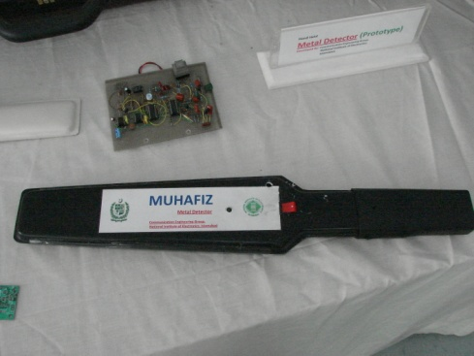
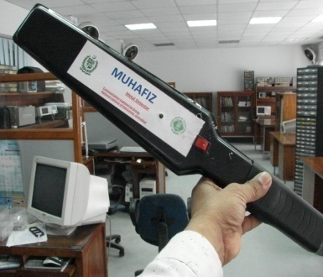
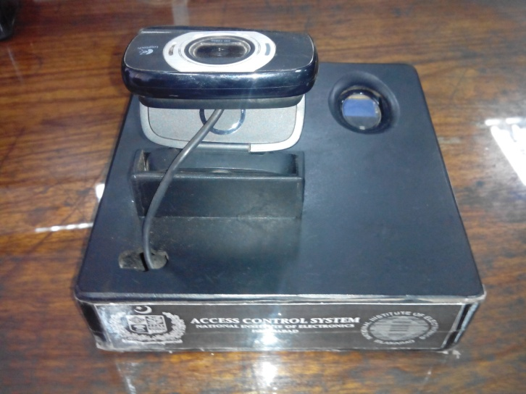
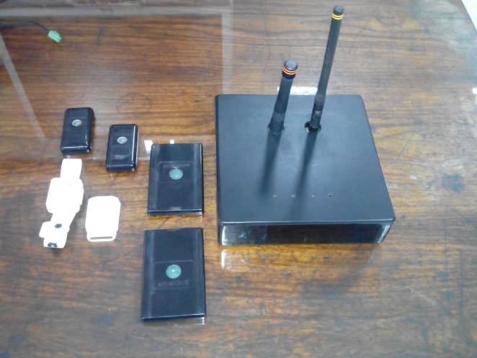
Communication Engineering
Development of Access Control System for Security:
- Biometric Access Control System
- RFID Vehicle Identification/Inventory Control System
Development of Handheld Metal Detector
Development of Specialized Optical System

Slide 15
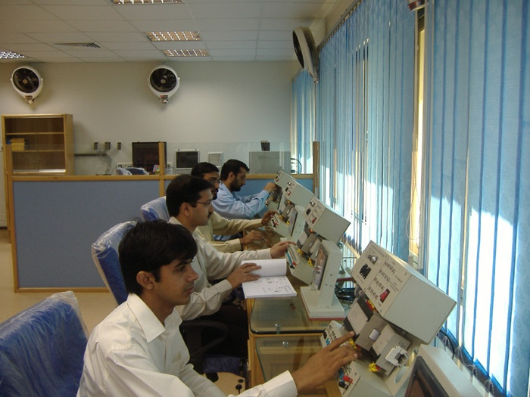
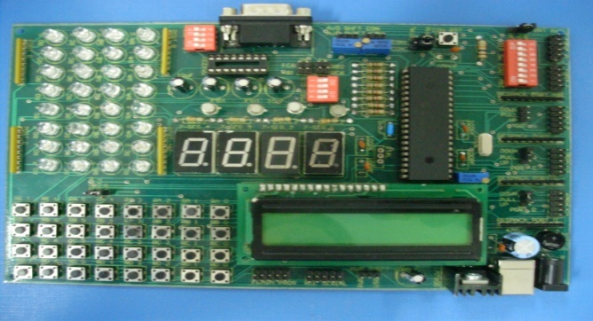
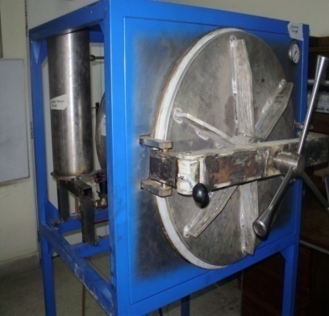
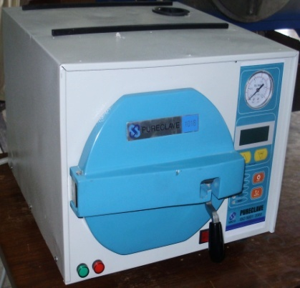
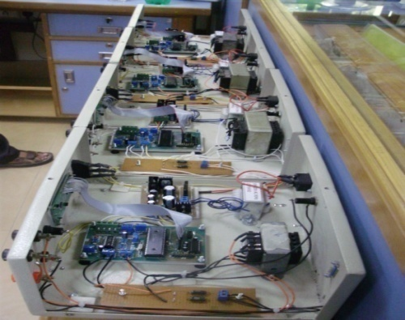
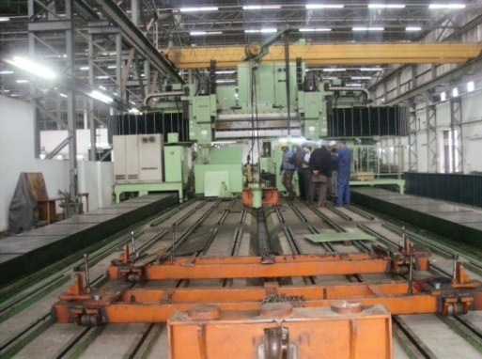
Automation Control Engineering
High Rating Automatic Voltage Stabilizers
Programmable Logic Controllers (PLCs)
Elevator Model for Multi- Storey Buildings
Controllers for Autoclave (N type)
Transformer Turns Ratio Finder
CNC Engraver (wood, metal etc)
15
15

Slide 16
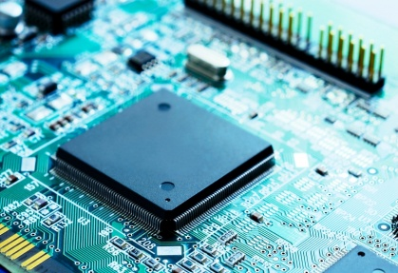
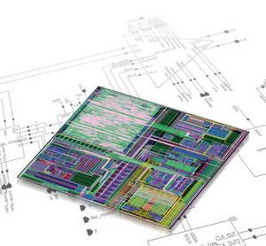
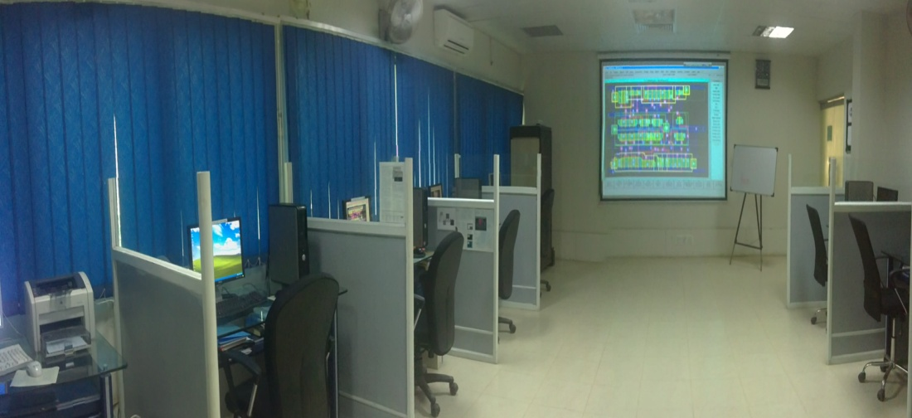
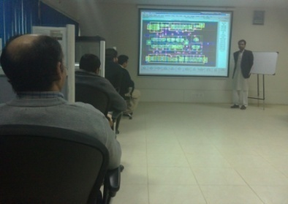
Integrated Circuit Design
Equipped with Advanced IC design Tool from Mentor Graphics USA
Design, Physical Layout & Verification of Digital Analog and Mixed Signal ICs
Promotion of IC Design Technology in the country
Advance Training to Engineers/Scientists/ Faculty Members of Universities and R&D Organizations
Research Publications.
16
16

Slide 17
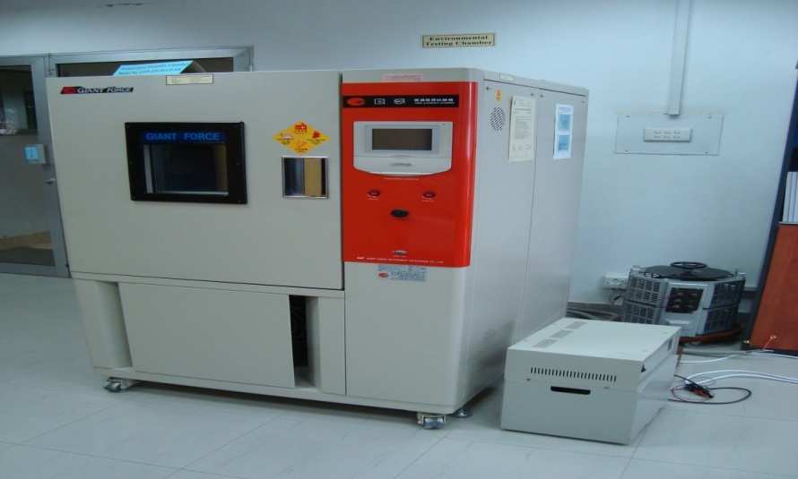
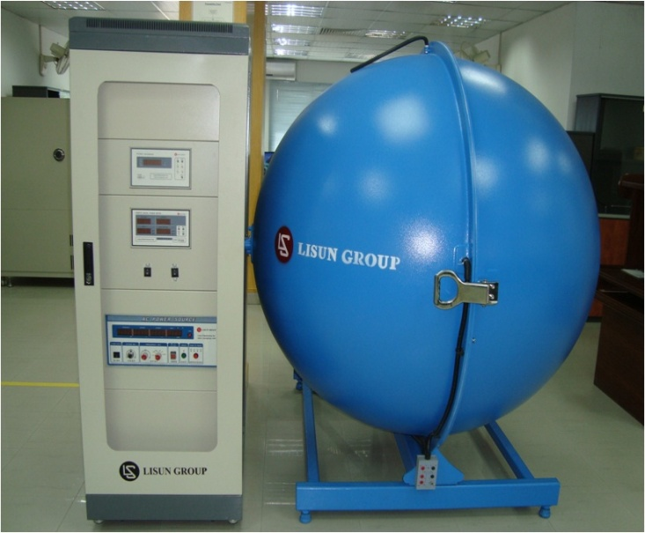
Services and Consultancy
Testing of Electronic Product (Lab Qualified and Recommended for Accreditation ISO 17025 Standard .)
Electrical Safety Tests
EMC/EMI Test (Conducted Immunity Test)
Environmental Test
Specification Tests
Lamp Test
Calibration of Electronic Test Equipment

Slide 18
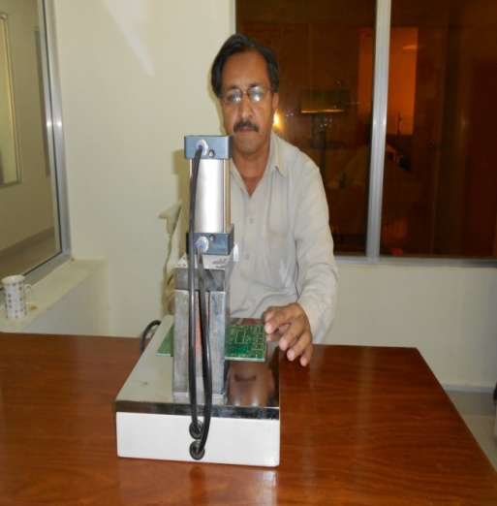
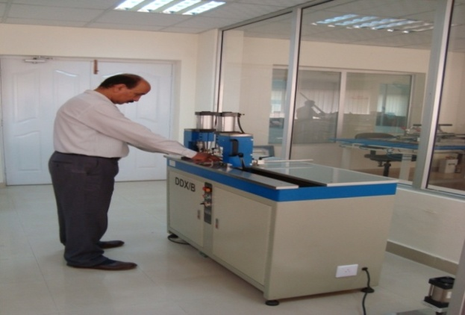
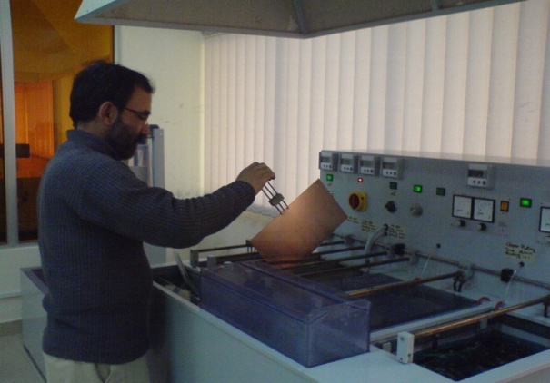
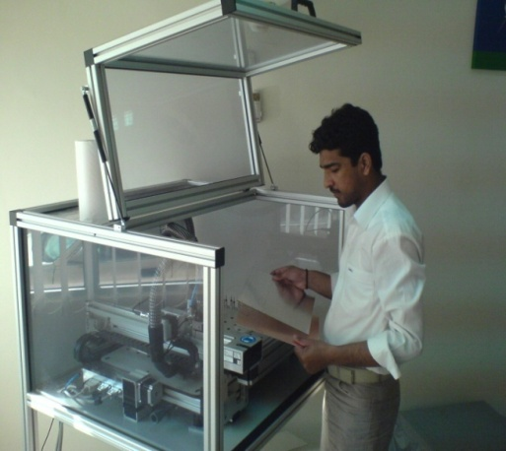
PCB Design & Fabrication Facility
Printed Circuit Board (PCB) Design and Fabrication
Double Layer PCBs (Upto Six Layer)
Multilayer PCBs
Services Provided to Public & Private Sector

Slide 19
Recent Activities (i)
Pakistani delegation headed by Mr. Rana Tanveer Hussain Federal Minister for Science & Technology visited China -South Asia Technology Transfer Center. Followed by signing of different agreements for Technology Transfer & Collaborative Innovation.
In follow-up of this visit, National Institute of Electronics (NIE) signed a contract agreement for production of batteries at NIE.
19

Slide 20
Recent Activities (ii)
For installation of Solar Water Pumps (site selected) and feasibility report of 30,000 pumps is under process.
In F/Y 2015-16 Government of Pakistan will launch installation of 10,000 Solar Water Pumps. This task may be assigned to NIE with bifurcation of 5000 in each slot
Installation of Solar Street Lights by NIE
NIE will be responsible for Repair & Maintenance of Batteries, Solar Water Pumps & Solar Street Lights etc as per warranty.
20

Slide 21
Marketable Products
High Precision Electronic Detonating System (Developed)
LED Lights (Developed)
Street Lights (32w, 50w, 70w & 100w)
2x2 Panel Lights 36w
Down/Spot Lights of Different Powers
CAT (Computerized Automobile Tuning) (in progress)
Maintenance Free Batteries for alternate energy (in progress)

Slide 22
Benefits
HPEDS bulk production up to 1 lac pieces
6.5 Mega watts would be saved on installation of 50,000 LED lights.
Sr # | Products/ Items | Nonstandard Wattage Consumption | Standard/ Energy Efficient Wattage Consumption | Saving in Watts | Number of items replaced | Overall saving in (Mega Watt)
1. | Electric Fans | 100 | 60 | 40 | 50,000 | 2
2. | 2*2 Light Panel | 92 | 36 | 56 | 50,000 | 2.80
3. | Road Lights | 250 | 100 | 150 | 50,000 | 7.50
Total saving on National Grid on replacement of 1,50,000 Items |  |  |  |  |  | 12.30

Slide 23
Benefits
Computerized Automotive Tuning & fault diagnostic facilities to enhance fuel efficiency, repair/maintenance and power optimization of vehicles.
Complete reliable alternate energy source through use of LED lights, solar panels and Batteries.

Slide 24
Business Plan
Collaboration with National & International Agencies for Conservation of Energy Projects.
Public Private Partnership (in progress)
Awareness Campaign for standardization of Electronic Products.
To Train the Trainers in Fault Detection/Repair for Automotive, PLCs, ICs & PCBs etc

Slide 25
Innovative/Future Products
HPEDS will be used in Shells. (Air burst, delay fuse etc.)
Smart Solar Street Lights, Water Pumps etc (Automatic Integrated Control for Energy Saving)
For Automotive, Development of ECU, Data Logger, Collision Detection Sensors.
Generation of value added HR/Master Trainers in High Tech CAT facilities to address the fault diagnostic procedures.
Technical Business Incubation Centre (Medical Electronics Equipment, Maintenance free Batteries & Energy Saving Appliances).

Slide 26
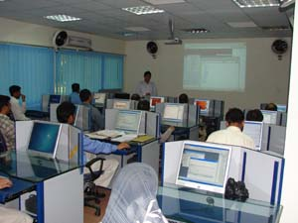
Training / Human Resource Development
Training provided to 19000 trainees in the fields of Electronics
Internship provided to more than 500 Internees
Advanced Trainings:
PLCs, HMI, SCADA
IC Nanometer Design
Oracle Financial & Data Bases

Slide 27
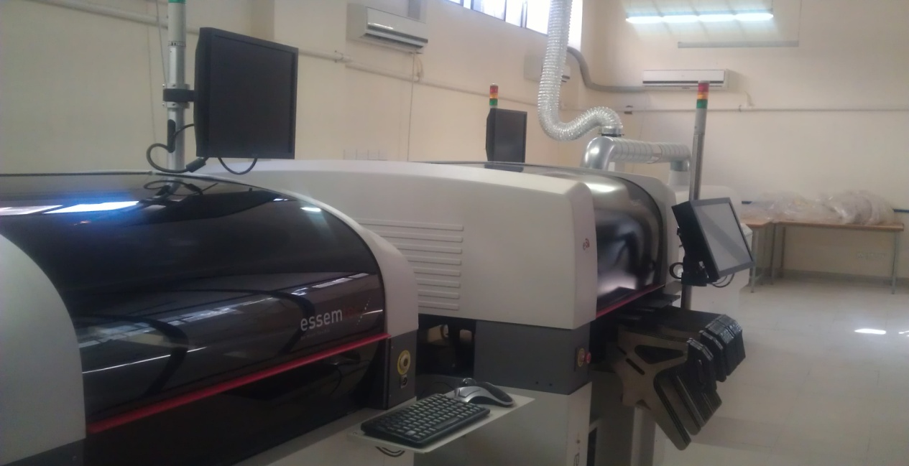
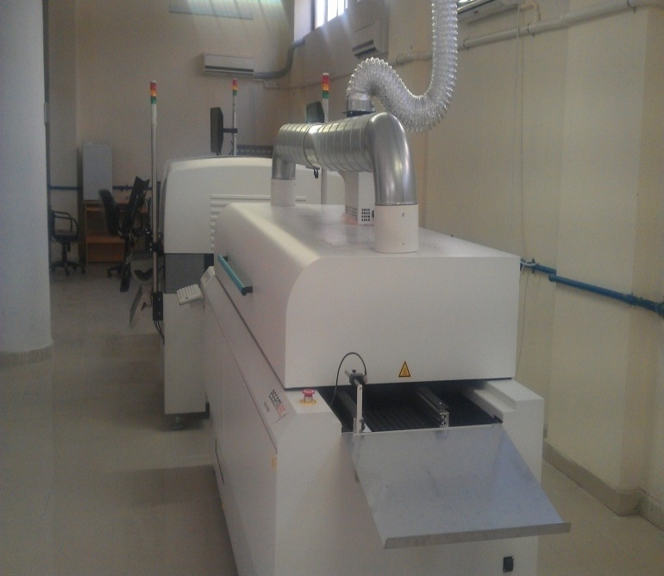
Small Scale Production
Manufacturing of Various Types of Electronic Boards
Manufacturing of SMT LED Panels
Saving of Energy through LED Lights
27

Slide 28
PSDP Projects
Balancing Modernization & Rehabilitation (BMR) of NIE
(Total cost Rs 490.00 M)
To transform Institute into a modern, progressive and forward looking organization of National Standing.
To manufacture PCB for SMT electronic products.
To upgrade existing facilities and establish new facilities to undertake projects of national importance.

Slide 29
Joint Projects with NESCOM
National Electronics Complex of Pakistan (NECOP)
The NECOP is a joint PSDP project of Ministry of Defense executed by NIE & NESCOM with technical & financial assistance of China.
The project was approved by ECNEC in July, 2011 with a Total Cost of US$ 300 M (9 Years) started in 2012.
The strategic part of NECOP will be handled by NESCOM while commercial/ industrial activities by NIE.
One of the sixth Technology Centers of NECOP has been established at NIE.

Slide 30
Problems and Issues
Financial Incentive/Career Planning for Retention of Technical Manpower. In 1995, loss of foreign qualified 14 Phd and 40 MS. (Brain Drain)
Delay in Release of Funds increase manifold Project Cost.
Accommodation & Transportation.

Slide 31
Recommendations for Approval
Order for Installation of LED, Street Light, Solar Water Pumps should be given to NIE
Approval of funds for research projects and Value Added HRD through MoST, HEC, ICT R&D, & NAVTTC.
Tax waiver on import of Electronic Component & Eqpt.
Timely Release of Project Funds.
Construction of hostel / residential accommodation (space already available).

Slide 32
Thanks

Slide 33
GOVERNING BODY OF NIE
Director General NIE Chairman
Joint Secretary Policy & Implementation M/o Industries, Member Production and Special Initiative
Financial Advisor (S&T) Finance Div Member
Joint Electronics Advisor, MoST Member
Chief (S&T) Planning, Development & Reforms Member
Senior Project Manager (Engineer) M/o Information Member
Technology
Advisor (HRD) Higher Education Commission Member
Dir. Research./ System & Circuit Division (NIE) Member
Dir. Development/ Component Division (NIE) Member
Director NIE (Designated by the Chairman) Member/ Secy.

Slide 34
Vacancy Position as on 01-01-2015
Sr. No. | Post | BPS | Sanctioned | Occupied | Vacant | By Direct Recruitment | By Promotion
1. | Director General | 21 | 01 | 01 | 0 | 0 | 0
2. | Director Finance | 20 | 01 | 0 | 01 | 01 | 0
3. | Director of Divisions | 20 | 02 | 0 | 02 | 02 | 0
4. | Chief Research Officer | 20 | 05 | 0 | 05 | 01 | 04
5. | Dir. Technical Service & Cord. | 19 | 01 | 0 | 01 | 01 | 0
6. | Principal Research Officer | 19 | 08 | 07 | 01 | 00 | 01
7. | Senior Research Officer | 18 | 19 | 12 | 07 | 04 | 03
8. | Senior System Analyst | 18 | 01 | 01 | 0 | 0 | 0
9. | Audit & Accounts Officer | 18 | 01 | 01 | 0 | 0 | 0
10. | Administrative Officer | 18 | 01 | 0 | 01 | 01 | 0
11. | Deputy Director Personnel | 18 | 01 | 01 | 0 | 0 | 0
12. | Deputy Director Procurement | 18 | 01 | 0 | 01 | 0 | 01
13. | Library Officer | 18 | 01 | 01 | 0 | 0 | 0
14. | Publication Officer | 18 | 01 | 0 | 01 | 01 | 0
15. | PS to DG | 17 | 01 | 01 | 0 | 0 | 0
16. | Research Officer | 17 | 32 | 02 | 30 | 30 | 0
17. | Technical Officer | 17 | 06 | 04 | 02 | 01 | 01

Slide 35
18. | System Analyst | 17 | 02 | 0 | 02 | 02 | 0
19. | Project Documentation Officer | 17 | 01 | 01 | 0 | 0 | 0
20. | Store Officer | 16 | 01 | 01 | 0 | 0 | 0
21. | Superintendent | 16 | 01 | 01 | 0 | 0 | 0
22. | Assistant Procurement Officer | 16 | 01 | 01 | 0 | 0 | 0
23. | Principal Technician | 16 | 13 | 11 | 02 | 02 | 0
24. | Head Draftsman | 16 | 01 | 01 | 0 | 0 | 0
25. | Programmer | 16 | 01 | 01 | 0 | 0 | 0
26. | Assistant Private Secretary | 16 | 06 | 05 | 01 | 01 | 0
27. | Technical Photographer | 14 | 01 | 0 | 01 | 01 | 0
28. | Stenotypist | 14 | 05 | 02 | 03 | 03 | 0
29. | Assistant | 14 | 11 | 08 | 03 | 03 | 0
30. | Senior Technician | 13 | 35 | 17 | 18 | 18 | 0
31. | Draftsman | 13 | 02 | 0 | 02 | 02 | 0
32. | Store Keeper | 11 | 02 | 0 | 02 | 02 | 0
33. | Telex/Telephone Operator | 11 | 02 | 01 | 01 | 01 | 0
34. | U.D.C. | 09 | 01 | 0 | 01 | 0 | 01
35. | Skilled Worker | 07 | 02 | 0 | 02 | 02 | 0
36. | L.D.C. | 07 | 08 | 05 | 03 | 03 | 0
37. | Duplicating Machine Operator | 05 | 01 | 01 | 0 | 0 | 0
38. | Driver | 04 | 09 | 06 | 03 | 03 | 0
39. | Dispatch Rider | 04 | 01 | 0 | 01 | 01 | 0
40. | Chowkidar | 01 | 06 | 05 | 01 | 01 | 0
41. | Attendant | 01 | 20 | 16 | 04 | 04 | 0
42. | Mali | 01 | 02 | 01 | 01 | 01 | 0
43. | Sweeper | 01 | 05 | 04 | 01 | 01 | 0
Total: |  |  | 223 | 118 | 105 | 93 | 11

Slide 36
Major Head Wise Expenditure F.Y 2011-12
(Rs in Millions)
Head Code | Description | Budget Allocation | Expenditure incurred | Balance
A01 | Employee Related Exp. | 58.835 | 58.835 | 000
A02 | Project Pre-investment Analysis | 12.813 | 12.790 | 0.023
A032 | Communication | 0.740 | 0.740 | 000
A033 | Utilities | 4.120 | 4.120 | 000
A034 | Occupancy Cost | 10.606 | 10.606 | 000
A038 | Travel & Transport | 1.440 | 1.433 | 0.007
A039 | General | 1.076 | 1.076 | 000
A04 | Employees Retirement Benefit | 3.900 | 3.900 | 000
A063 | Entertainment & Gifts | 0.101 | 0.101 | 000
A09 | Physical Assets | 0.015 | 0.015 | 000
A094 | Other Stores & Stocks | 000 | 000 | 000
A096 | Purchase of Plant & Machinery | 000 | 000 | 000
A13 | Repair & Maintenance | 0.550 | 0.534 | 0.016
 | Total: | 94.196 | 94.150 | 0.046

Slide 37
Major Head Wise Expenditure F.Y 2012-13
(Rs in Millions)
Head Code | Description | Budget Allocation | Expenditure incurred | Balance
A01 | Employee Related Exp. | 69.890 | 69.890 | 000
A02 | Project Pre-investment Analysis | 0.200 | 0.140 | 0.060
A032 | Communication | 1.250 | 1.231 | 0.019
A033 | Utilities | 4.176 | 3.432 | 0.744
A034 | Occupancy Cost | 11.000 | 10.999 | 0.001
A038 | Travel & Transport | 1.960 | 1.868 | 0.092
A039 | General | 1.338 | 1.337 | 0.001
A04 | Employees Retirement Benefit | 5.000 | 5.000 | 000
A063 | Entertainment & Gifts | 0.160 | 0.112 | 0.048
A09 | Physical Assets | 0.040 | 000 | 0.040
A094 | Other Stores & Stocks | 000 | 000 | 000
A096 | Purchase of Plant & Machinery | 000 | 000 | 000
A13 | Repair & Maintenance | 0.480 | 0.336 | 0.144
 | Total: | 95.494 | 94.345 | 1.149

Slide 38
Major Head Wise Expenditure F.Y 2013-14
(Rs in Millions)
Head Code | Description | Budget Allocation | Expenditure incurred upto 1st , 2nd & 3rd Qtr | Expenditure incurred in 4th Qtr | Balance
A01 | Employee Related Exp. | 70.300 | 53.157 | 17.142 | 0.001
A02 | Project Pre-investment Analysis | 000 | 000 | 000 | 000
A032 | Communication | 0.770 | 0.545 | 0.225 | 000
A033 | Utilities | 3.234 | 2.139 | 1.095 | 000
A034 | Occupancy | 13.600 | 9.879 | 3.721 | 000
A038 | Travel & Transport | 1.240 | 1.144 | 0.096 | 000
A039 | General | 0.935 | 0.569 | 0.321 | 0.045
A04 | Employee Retirement Benefits | 5.000 | 4.317 | 0.683 | 000
A063 | Entertainment & Gifts | 0.035 | 0.032 | .003 | 000
A13 | Repair & Maintenance | 0.327 | 0.143 | 0.184 | 000
 | Total: | 95.441 | 71.925 | 23.470 | 0.046

Slide 39
Visit of High Dignitaries/Delegation
Federal Minister S&T
Federal Secretary S&T
Federal Secretary M/o Industries & Production
Delegation of Y.O Kim Head of SMT business in SAARC region
Federal Secretary M/o Defence
Delegation of PakOASIS Multinational Company
Chairman, NESCOM
Delegation of SAMSUNG Korean
High Power Delegation of KRL
Head of NRTC Haripur

Slide 40
R&D WORK UNDERTAKEN SINCE 1986 (1)
Objective : R&D in vital areas of electronics
Industrial Process Controllers (1985)
Traffic Light Controllers (1992-94)
Green-house Controllers (1998)
Parallel Processing System (1988-89, 1992-93)
Switching Systems (Telephone Exchanges) – 1982-89
Digital Dial Chip
Objective : Items of common utility
Power Supplies (various ranges) – 1993 for GIK Institute Topi
Voltage Stabilizers ( 1 kVA to 5 kVA) – 1982-86
Uninterruptible Power System (UPS) -
Motor Speed Controllers (3 phase inductive motors)
Hand Dryers (1994)
PABXs ( 2 X 10 lines & 8 X 100 lines)
Hearing Aids (1994 for Ministry of Special Education)
Objective : Know-how in advance electronic techniques
Chip Design Technology
Chip Manufacturing Technology
Control Engineering
Power Electronics
Advance Communication Techniques
Feasibility report on production of proximity fuses

Slide 41
R&D WORK UNDERTAKEN SINCE 1986 (2)
Objective : Contractual/ Customized Projects
Artillery fire control computer system for Pak Army (1984-)
Special purpose PABX for PAK Army (1989)
Traffic Light Control for CDA (1994-95)
Radio Paging System for Hospital
Communication Products for ISI and Punjab Police
High Power Inverter for UNDP (1989-90)
Fiber Optic Communication link for PTCL (1985)
Specialized Process Controller for Fauji Foundation Fertilizer Plant
Machi Goth (RYK) (1994)
Hearing Aid for Ministry of Special Education (1994)
Fabrication of Printed Circuit Boards for large number of organizations (NESCOM, DESTO, PMO etc)
Establishment of Electronics Development Center in NWFP (1991-92)

Slide 42
Achievements for Last Five Years
Establishment of SMT Pilot Production Line
Double and multilayer printed circuit boards (PCBs)
Integrated Circuit Design Centre
Centre for software development and training in advance databases
Centre for quality testing and certification of electronics products
Up-gradation of power electronics lab
LED based energy efficient lights
Communication Surveillance Devices
Electronic Voting Machine

Slide 43
Achievements for Last Five Years
Programmable Logic Controllers (PLCs)
Autoclave unit
CNC machine
Elevator for Multi- Storey Buildings
High Rating Automatic Voltage Stabilizers
Transformer Turns Ration Finder
Hand Held Metal Detector
Access control system
Communication surveillance devices
Engineering/consultancy services
Advanced trainings / internship

Slide 44
DIRECTOR GENERALS (Since 1979)
 | Name | Period
1 | Dr. Nisar Ahmed (Acting Charge) | 1979-79
2. | Maj. Gen. Shafiq Ahmed (Acting Charge) | 1979-80
3. | Mr. Manzoor Ahmed (Acting Charge) | 1980-82
4. | Mr. Masihuddin (Acting Charge) | 1982-84
5. | Brig. (R) M. Sardar Khan | 1984-85
6. | Mr. Masihuddin (Acting Charge) | 1985-87
7. | Dr. S. Ahmed Husnain | 1987-89
8. | Mr. Tariq Ubaid (Acting Charge) | 1990-92
9. | Mr. Tariq Ubaid | 1992-95
10. | Mr. Muhammad Ishaq (Acting Charge) | 1995-96
11. | Dr. S.M. Qureshi (Acting Charge) | 1996-96
12. | Lt. Gen (R) Javed Ashraf Qazi (Acting Charge) | 1996-96
13. | Mr. M. Ayub Iqbal Rana | 1996-99
14. | M. Idrees Anwar (Acting Charge) | 1999-00
15. | Mr.Anwar Jamal Ansari | 2000-03
16 | Mr. Shehryar Khan (Acting Charge) | 2003-04
17. | Dr. Anwar ul Haq (Acting Charge) | 2004-05
18. | Dr. Pervaiz Akhtar (Acting Charge) | 2005-05

Slide 45
DIRECTOR GENERALS (Since 1979)
 | Name | Period
19. | Prof. Dr. Farid A. Khwaja (Acting Charge) | 2005-08
20. | AVM Tariq Matin (Acting Charge) | 2008-09
21. | Mr. Tariq M. Ubaid Wahla (Acting charge) | 2009
22. | Mr. Muhammad Aslam (Acting charge) | 2009-10
23. | Mr. Zafar Iqbal Khokhar, Acting Charge | 2011 -13
24. | Mr. Saiful Islam Qureshi, Acting Charge | 2013-14
25. | Mr. Abdul Haleem Asghar, Acting Cahrge | 2014
26. | Brig. Dr. Basharat Mehmood | 31-12-2014 – to date
Acting Charge: 20 times (24 Years, 69 %)
Full Time: 06 times (11 Years; 31 %)

